Slide 1
Self adjusted auto provision system at resource level
Weekly report 15th April
You Hu

Slide 2
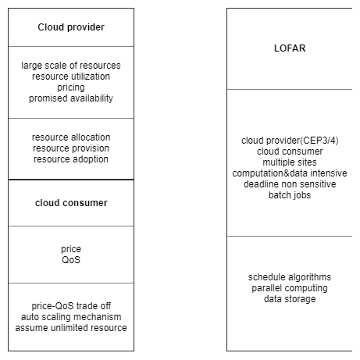
Recap – Background & Requirements
It is close to the case of private cloud

Slide 3
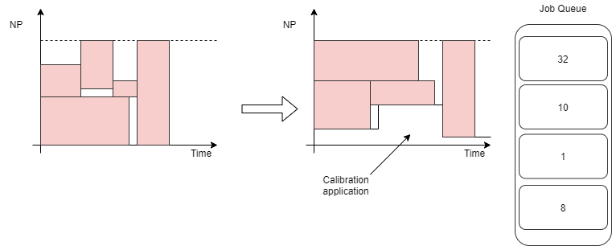
Recap – issue and research question
How to increase the resource utilization level in a batch cluster?
Use calibration applications to fill in the blank.
It requires: auto scaling/provisioning;

Slide 4
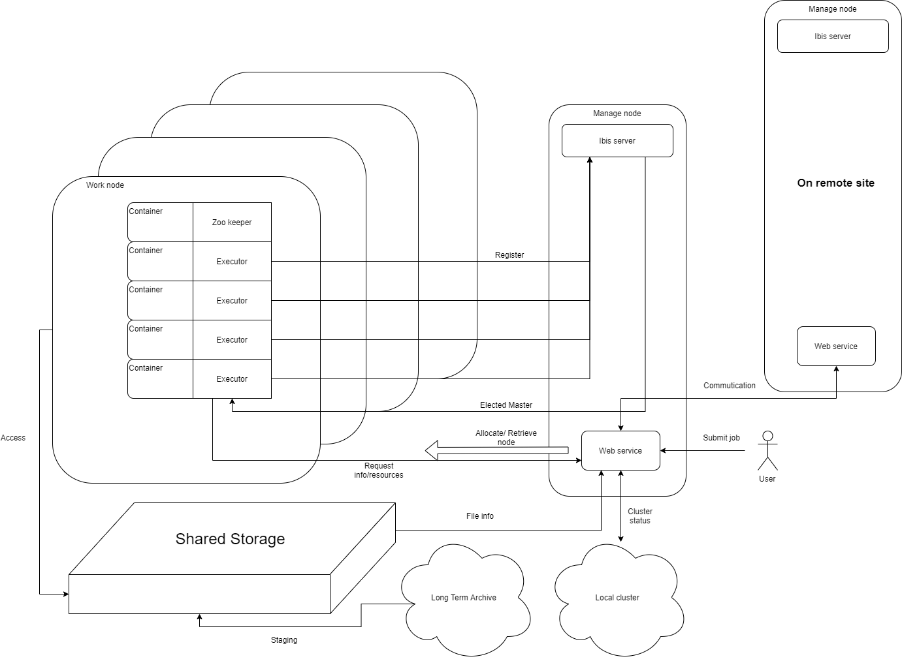
Recap – Rough design

Slide 5
Questions statement
Distributed algorithm/architecture: Master – worker
Communication: IPL -> Ibis server(s-for backup)
Resource management algo:
Estimate job execution time
Schedule->SLURM+Xenon
Dynamic adjust: a metrics for trading off(time to start and shut down nodes)
Fault tolerance
Node manage: master->re-election; worker->task persistence
Tasks(NO snapshot): Zookeeper/Redis/any lightweight distributed database
Data locality: move comp rather than move data
Remote sites
Shared storage
Data aware(?)

Slide 6
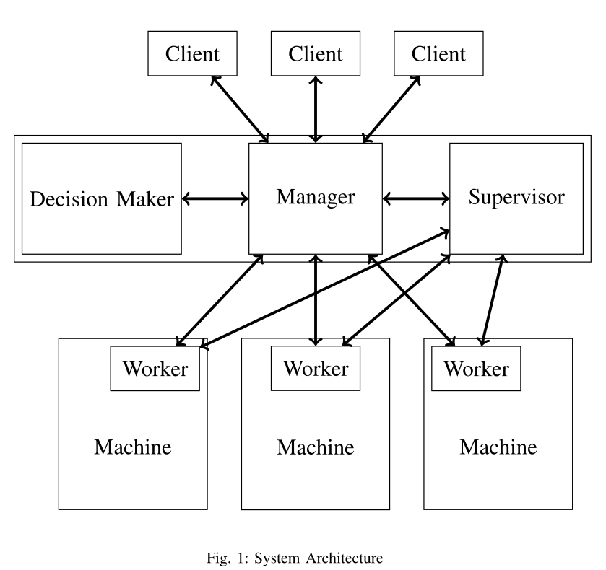


Existed research
Batch
$$f_{b}(X1,X2…X)$$
Minimize penalty
&
Schedule
Interactive
$$f_{i}(X1,X2…X)$$
The penalty calculation is based on SLA
Chang, T. W., Lin, C. C., Liu, P., Wu, J. J., Shih, C. C., & Huang, C. W. (2016). Resource provision for batch and interactive workloads in data centers.

Slide 7
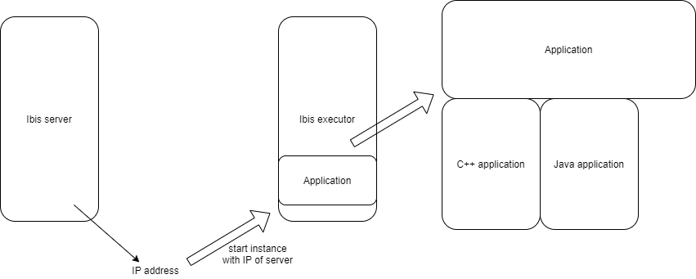
Current experiment – Ibis + JNI + container
The JAVA and C++ applications have been compiled when the images of executor built(by Gradle)

Slide 8
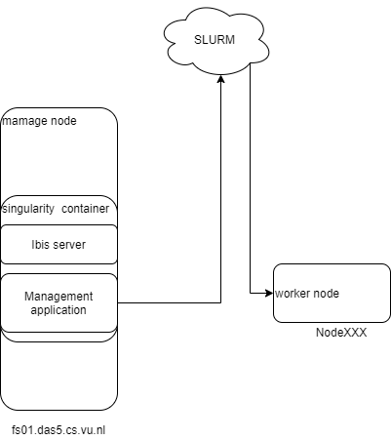
Current experiment – Xenon + SLURM
Problems:
No container now: port mapping(where is ibis server?)
Can not connect head node: × location = "ssh://localhost“

Slide 9
Other topics
Remarks on the design
Ibis and Xenon, how to excavate the potential of them on this application
Schedule management of SLURM
Next phases
Literature study
Experiments

